Slide 1
Module 1 – Getting Started

Slide 2
Recommended Preparation Before Class
Attend a live SkySpark Deep Dive presentation. We publish our calendar here: http://www.skyfoundry.com/forum/calendar
Review the User App Training Videos (Section III): https://skyfoundry.com/doc/docTraining/index
Complete the post setup exercises at the end of this presentation.
Watch these videos for extra credit:
Section II - Resolving License Errors and Warnings: https://skyfoundry.com/doc/docTraining/LicenseErrs
Section IV - Settings App: https://skyfoundry.com/doc/docTraining/SettingsApp
Section IV - Rule Views: https://skyfoundry.com/doc/docTraining/RuleViews
Section V - Nav Options: https://skyfoundry.com/doc/docTraining/ViewNav

Slide 3
SkySpark EssentialsⓇ Overview
SkySpark Essentials training is presented in 5 modules.
Module 1 is completed prior to the class.
The goal of Module 1 is for students to:
Install SkySpark on a computer they will use during training
Generate the SkySpark demo project
Become comfortable using the end user SkySpark Apps

Slide 4
Installing SkySpark

Slide 5
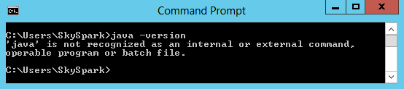
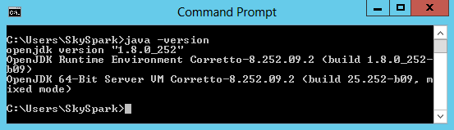
Verify Java Setup
SkySpark requires a Java Runtime Environment (JRE)
Open a command prompt/terminal and run the command: java –version
If an error is reported, then Java is either not installed or the operating system path is not configured properly. Refer to next slide for Java installation resources.
If version information is reported then proceed with SkySpark Installation.
2
3
Java Home Documentation: https://www.skyfoundry.com/doc/docSkySpark/Setup#javaHome

Slide 6
High Level Overview of Java Requirements
SkySpark requires Java 8 or later. Install 64-bit Java (x64) unless there is a hardware requirement to use 32-bit.
Starting with Java 11, Oracle releases the Java Development Kit (JDK) two ways:
Open Source Oracle OpenJDK - GPLv2+CPE license
Oracle JDK – Paid commercial license
End customers may require the use of a specific JDK.
Regardless of what JDK is used, ensure there is a plan in place to install Java security updates.
The JRE (the java binary) is included with the JDK, while in the past the JRE was available separately.

Slide 7
Java Providers
There are several providers of OpenJDK based distributions that will provide free updates (including security updates).
It is your responsibility to choose a Java distribution and ensure your usage of Java complies with the providers license.
SkyFoundry does not require the use of any specific provider.
Oracle OpenJDK is available from: http://jdk.java.net
Amazon’s OpenJDK distribution (Corretto) has good documentation and no cost: https://docs.aws.amazon.com/corretto/latest/corretto-8-ug/downloads-list.html

Slide 8
Download SkySpark
Navigate to https://skyfoundry.com and click on the Community tab at the top.
Login using your personal credentials. If you don’t have an account, email the instructor to set one up.
Click the Downloads tab and download the current version. It's just a zip file.
If a direct link was provided by the instructor, use that to download SkySpark.
Depending on your business relationship with SkyFoundry, you may not have Download access.
Watch SkySpark installation video for the target operating system:
Windows: https://skyfoundry.com/doc/docTraining/SetupWin
Linux: https://skyfoundry.com/doc/docTraining/SetupLinux
SkySpark Setup Documentation: https://skyfoundry.com/doc/docSkySpark/Setup

Slide 9
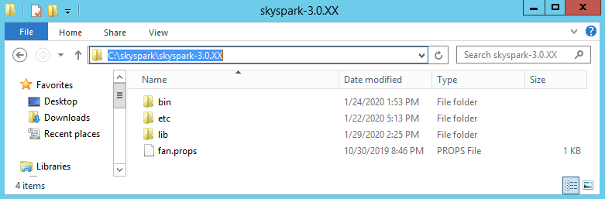
SkySpark Installation
Unzip the downloaded file and put the SkySpark build directory in an easy to find root directory, such as C:\skyspark.
The directory of the SkySpark build should be something like: C:\skyspark\skyspark-3.0.25 (make sure there isn’t a nested folder such as C:\skyspark\skyspark-3.0.25\skyspark-3.0.25).
NOTE: For production deployments, it is a best practice to install applications on a different disk than the Operating System, such as E:\

Slide 10
Launch Initial SkySpark Setup Wizard
Open a command prompt/terminal, navigate to the SkySpark bin directory, by running this command: cd C:\skyspark\skyspark-3.0.25\bin
Run this command: setup
When using Linux or OSX, run this command from inside the bin directory to set the permissions for the contents of the directory: chmod +x *
With Linux or OSX, the command is ./setup
Continue to next slide.

Slide 11
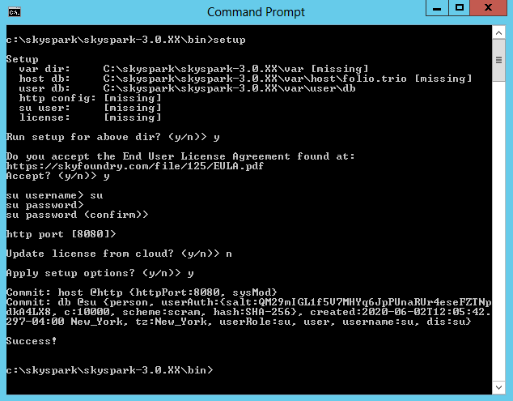
Complete SkySpark Setup Wizard
Run setup for the above dir: y
Accept EULA: y
Enter su username: su
Enter su password: [type twice – the cursor will not move]
Enter http port: [unless required to change, press enter to use default port 8080]
Update license from cloud: n
Apply setup options: y
1
2
3
4
5
6
7

Slide 12
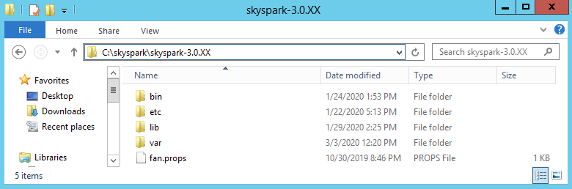
Important Notes on SkySpark Setup
Do not lose the su username/password. This only exists in the local SkySpark installation. SkyFoundry does not know or have access to this account.
The initial su account has the super user role assigned. A user with the super user role is required to manage the SkySpark host and perform initial setup tasks, such as creating a project.
Now there is a new var directory created in the SkySpark build directory, but a license file must be added to the var\lic directory.

Slide 13
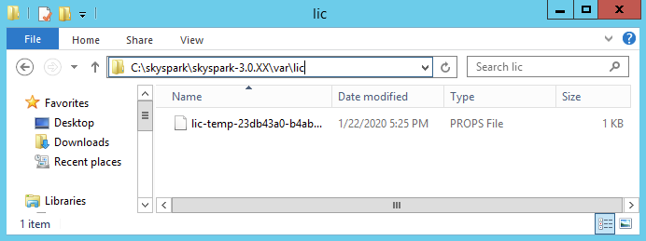
SkySpark License Installation
Every SkySpark host requires a unique license file. Contact the instructor if you do not have a SkySpark license file.
Copy the license file into var\lic directory.

Slide 14
Starting and Accessing SkySpark

Slide 15
Starting SkySpark
Open a command prompt/terminal, navigate to the SkySpark bin directory, by running this command: cd C:\skyspark\skyspark-3.0.25\bin
Run this command: skyspark
With Linux or OSX, the command is ./skyspark
This launches SkySpark from the command prompt/terminal. Leave the command prompt/terminal running in the background.
To stop SkySpark, type ctrl+c while the command prompt/terminal is the active window.
To restart SkySpark, press up to bring up the last command and press enter.
Not required for the training course, but it is recommended to run SkySpark as a service in production.
Windows: http://www.skyfoundry.com/doc/docSkySpark/Setup#runWinService
Linux: https://skyfoundry.com/doc/docTraining/SetupLinuxService

Slide 16
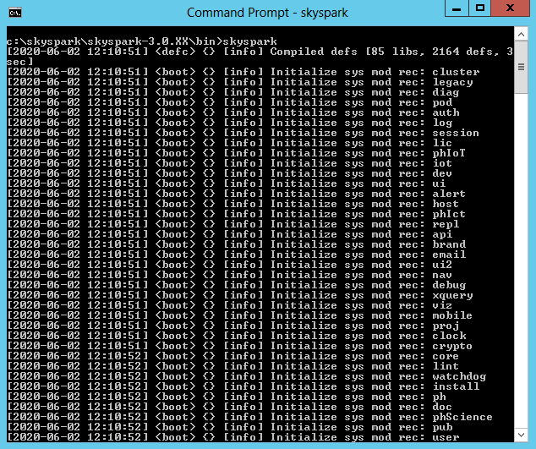
First Time Starting SkySpark
The first time, SkySpark is started, there will be several messages printed to the console.
This is expected as the var/host/folio.trio file is created/updated.

Slide 17
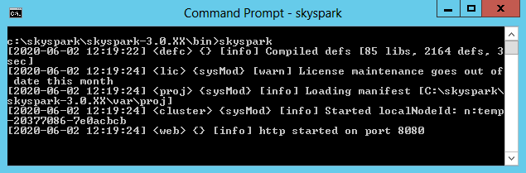
Things to check when Starting SkySpark
SkySpark starts a web server daemon that is listening on the configured port (configured during the SkySpark Setup Wizard) so make sure a message stating http started on the configured port is shown.
When using a temp license for training, there will likely be a warning about license maintenance going out of date. That isn’t important for training, but something to track in production.
SkySpark Licensing Documentation: https://skyfoundry.com/doc/docSkySpark/Licensing

Slide 18
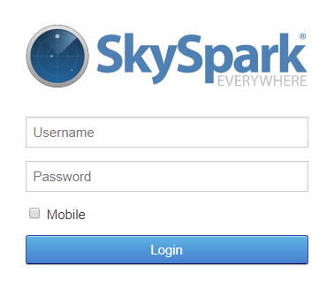
Login to SkySpark
Open a web browser and type this into the address bar:
http://localhost:8080
If connecting to SkySpark on a different computer, use whatever address and port SkySpark is running on.
Login using the su account created during the SkySpark Setup Wizard.

Slide 19

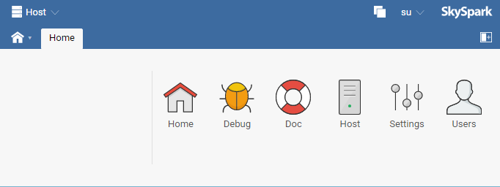
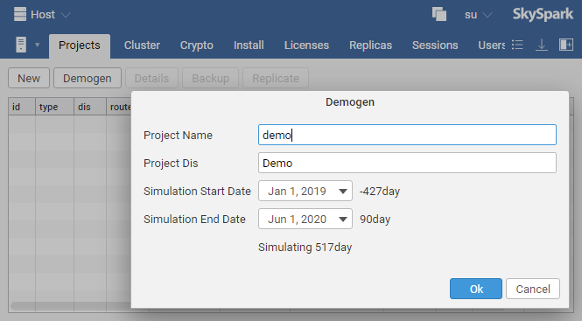
Generate the Demo Project
Host
After logging in, click the Host app.
On the Projects tab (default tab when opening the Host app), click the Demogen button then click Ok.
1
2
NOTE: This process may take a few minutes (check status in the command/prompt terminal). ~200 points of license capacity is used for the demo project.

Slide 20
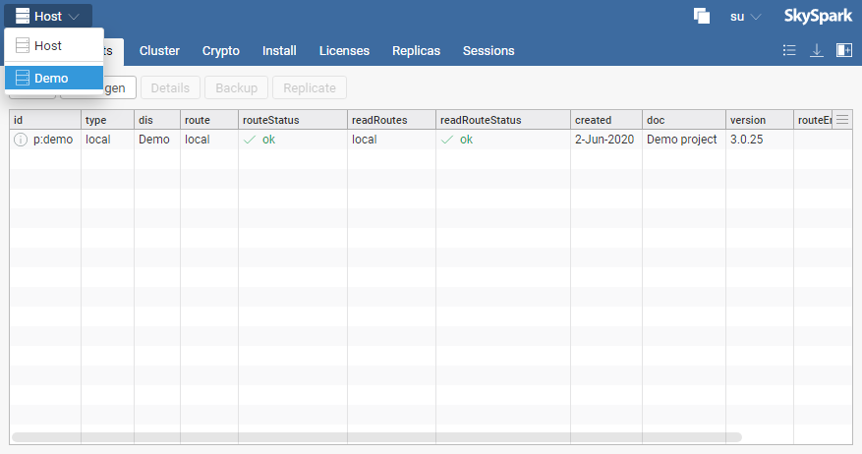
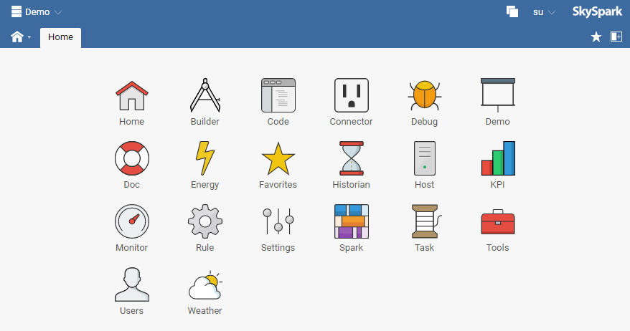
Accessing the Demo Project
Host
Click the Project picker in the top left corner.
Select the Demo project from the drop down.
1
2

Slide 21
Updating SkySpark

Slide 22
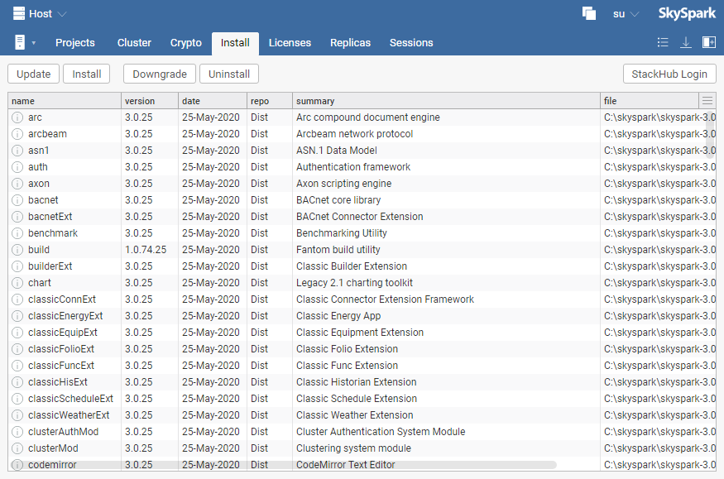
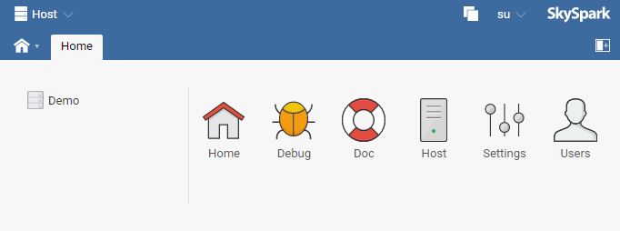
Checking for Updates in the Host App part 1
Go to the Host app.
Click the Install tab.
Click the Update button.
Continue to next slide.
2
3
1

Slide 23
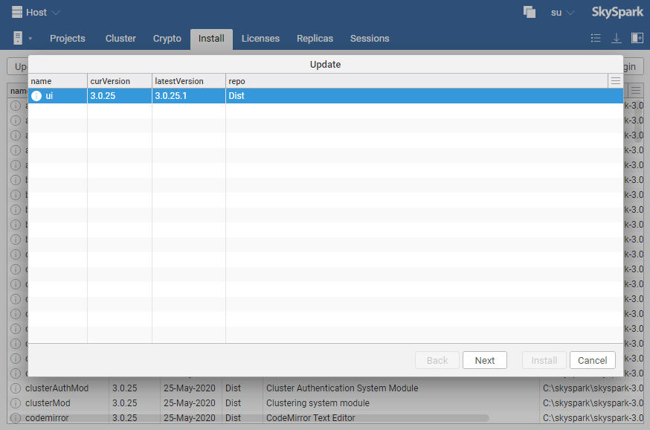
Checking for Updates in the Host App part 2
Select all patches by clicking the first patch, holding shift, then clicking the last patch.
Click Next.
Continue to next slide.
1
2

Slide 24
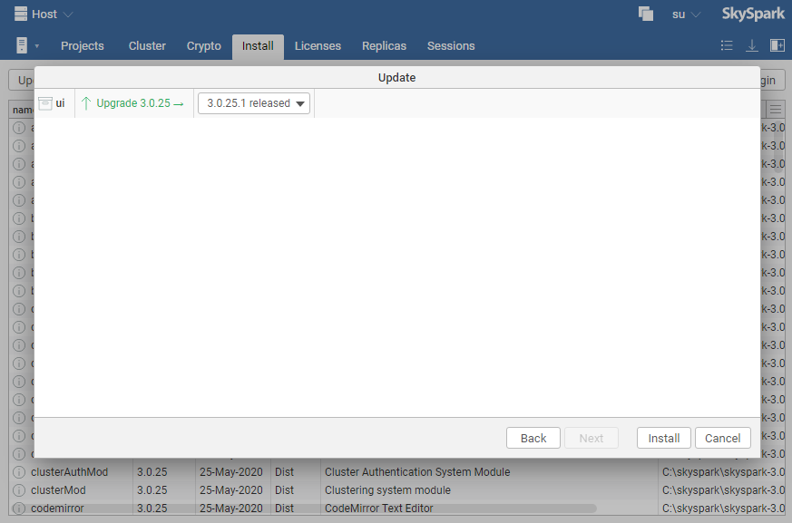
Checking for Updates in the Host App part 3
Click Install.
Continue to next slide.
1

Slide 25
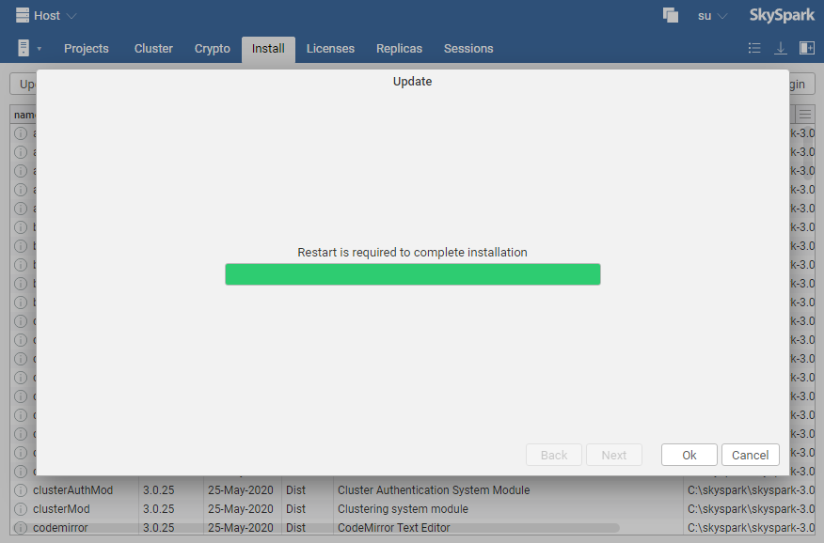
Checking for Updates in the Host App part 4
Success!
Restart SkySpark.

Slide 26
Post Setup Exercises to Gain Familiarity with the SkySpark User Apps

Slide 27

Spark app
Spark
Use the Spark app to explore the following Views:
All Sparks for Gaithersburg for a week period.
AHU Cool and Heat sparks for All Sites for a month period.
Select any 2 of the 4 sites and view all Rules for the current month.
Save any of the above views as a favorite for access in the Favorites app.
Export one of the above views as a PDF.

Slide 28

Energy app
Energy
View usage data for yesterday - normalized for area and weather
Export the above as a PDF file. View the file.
View the above data with the Relative rank tool
Add a baseline of previous year to the above
Change the point to kWh and view as a chart (remove the rank selection)
Export this view to Excel. View the data.
Save this selection as a Favorite with a date selection of Last Week

Slide 29

KPI app
KPI
View the full set of available KPIs for the current month
Select only the kWh Delta vs Prev Year KPI for viewing. Export as a PDF.
Select all of the KPIs. View the Info pop-up available in that screen.
View the KPIs only for the Gaithersburg site. Export the data in Excel format.

Slide 30

Historian app => Equip tab
Historian
View equipment data for various sites and for various time ranges
View the data for Gaithersburg, RTU-1 for yesterday. Add the following points to the default display: ElecMeter-Main, Consumption (kWh) and Demand (kW). Save this view as a favorite. Copy the link and email it to yourself so that you may click on it. (I copied the link in the browser bar, but had to sign-in and find the favorite manually.)

Slide 31
Information about Upgrading SkySpark

Slide 32
Migrating Projects from Older Versions of SkySpark
This slide is informational because when creating a project for the first time (such as when going to the Essentials training), no migration is required.
When SkySpark is upgraded, a migration may be required for existing projects.
Full notes on migration can be found here: https://skyfoundry.com/doc/docSkySpark/Migration
A migration is required to upgrade to these versions:
3.0.22
3.0.11
3.0.7
2.x to 3.x

Slide 33
Troubleshooting Installation

Slide 34
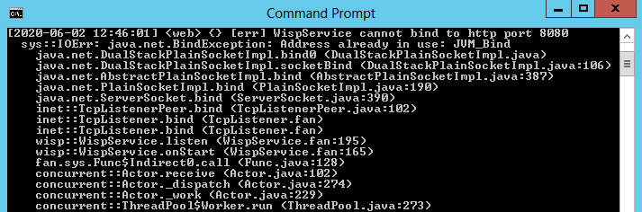
Possible Issues Preventing SkySpark from Starting
Cannot bind to port
Something is already running on the computer that is using the configured SkySpark port.
Make sure there isn’t another command prompt/terminal running with SkySpark already.
Re-run the SkySpark Setup Wizard and choose a different port.

Slide 35
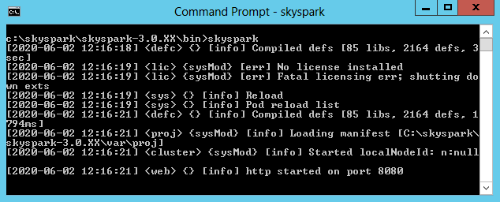
Possible Issues Preventing SkySpark from Starting
No license file
Double check that the license file was copied into the var/lic directory.
Double check the permissions on the var/lic directory.
Open the license file in a text editor and ensure it is not corrupt.
Re-download the license and copy the fresh file into the var/lic directory.
Restart SkySpark after making any license changes.
NOTE: The SkySpark web server daemon will still start without a valid license, but most functionality will be disabled.

Slide 36
End of Module 1

